Slide 1
Big Data Architecture and Governance
Group Project | Book Depository | Group 7
Bhagyashree Nair
Parth Jani
Smruti Jethwani

Slide 2

Introduction
Book Depository is the world's most international online bookstore offering over 20 million books with free delivery worldwide.
The Book Depository dataset comprises of 5 csv files-
1 main dataset file,
lookup files of the authors, book categories, formats, and publication places.
Kaggle link:
https://www.kaggle.com/datasets/sp1thas/book-depository-dataset?select=dataset.csv
The main aim of the project is to understand the dataset, churn information from them and extract useful insights through visualization.

Slide 3
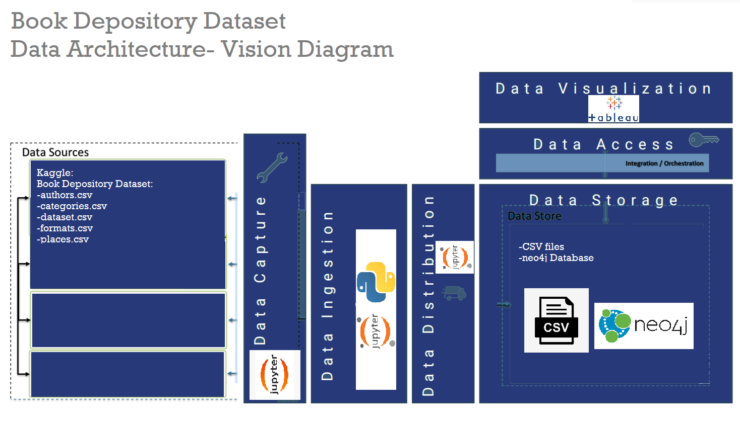
Vision Diagram
Data architecture of our project:
Data Sources:
Dataset files-
dataset.csv, authors.csv, categories.csv, formats.csv, places.csv
Data Capture performed on Jupyter notebook
Data Ingestion, Integration and Distribution performed on Jupyter Notebook
Data stored in csv files then imported to a neo4j database
Data Access done by JDBC drivers to connect to Tableau
Data Visualization performed on Tableau

Slide 4
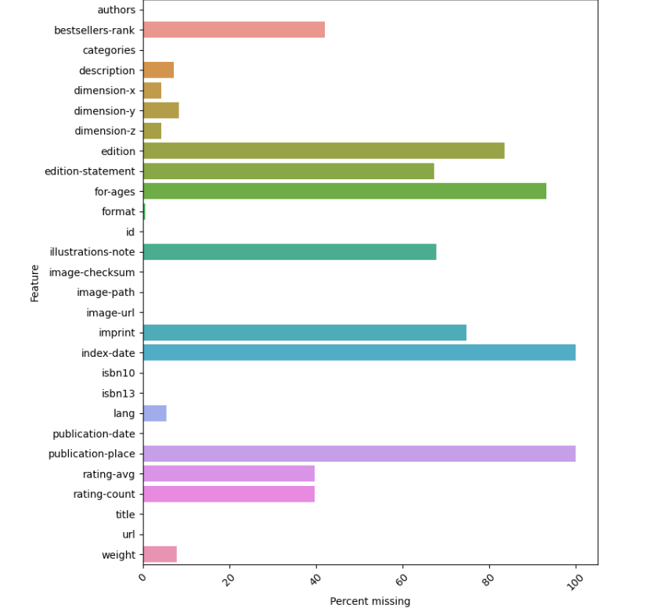
Data Profiling:
The dataset dimensions are as follows: 1109383 rows and 28 columns
Most of the main dataset features have null values. A visual depiction stating the columns and their null percentage is on the right.
The lookup tables did not contain any null values
Few points observed during data profiling:
Categories and authors were mentioned as a list which would not help us analyze it clearly, thus affecting our visualizations. data.explode() function was used to treat each value in the list as an individual record
‘url’ feature doesn’t contain the actual link to the book depository website. It had to be formatted to create a proper URL which can be later used to check mapping of the data.
2 attributes- index_date and publication_place have no data records and will therefore contribute nothing towards analysis and visualization

Slide 5
Data Wrangling and Cleaning:
Missing null value handling:
Our dataset comprised of a lot of null values. To handle them, we first differentiated between the numeric and categorical datatypes.
For numeric datatypes, we used the mean imputation method to replace the null values. For categorical datatypes, we provided a Customized 'missing information'
Index-date, publication-place had 1109383 null records and would not help in analysis, thus were dropped
Cleaning
Trimmed unwanted blank spaces
Merging the dataset with lookup files resulted in duplicate columns which were dropped
Double quotes in our ‘description’ attribute threw errors when loading to neo4j. This was replaced with single quoted to make it cleaner and solve neo4j loading problems
Attribute names with a ‘hyphen’ in them were not recognized and thus were renamed with an underscore

Slide 6

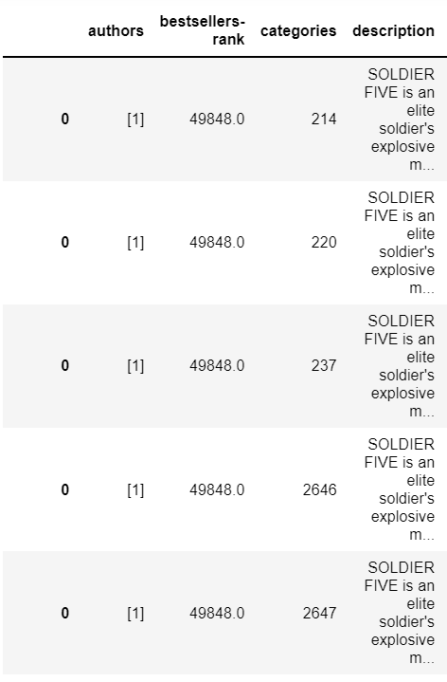
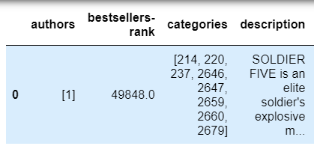
Data Wrangling and Cleaning:
Filtering and Aggregating:
We transformed each element of a category list and author list to a row, replicating the index values. This was done to incorporate records for every category a book belongs to and every author that published the book. This was implemented by using the data.explode() function.

Slide 7
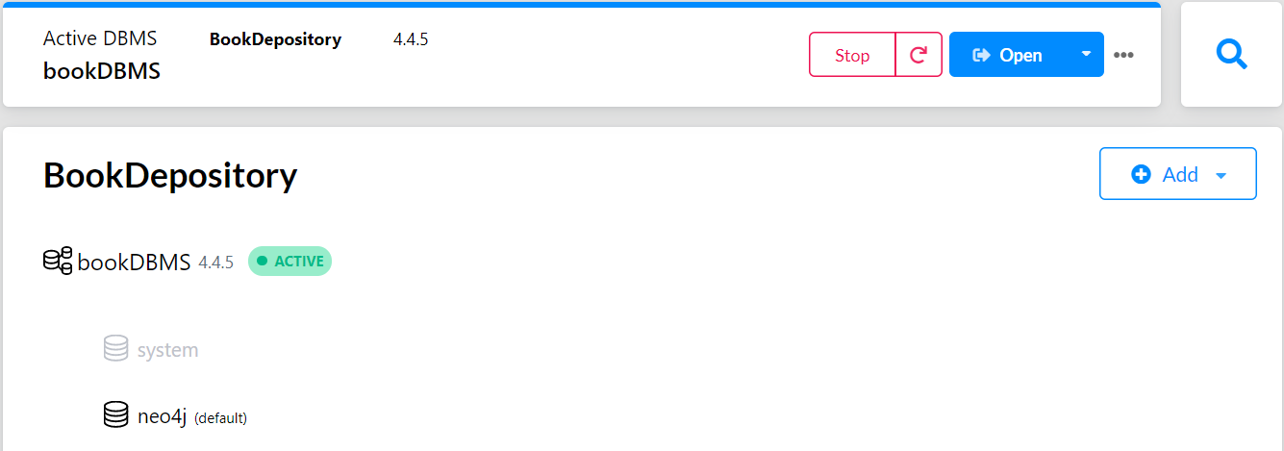
Database Installation:
We created a project on Neo4j: BookDepository
A Database was created in the project: bookDBMS

Slide 8
Data Mapping and Integration
Main data file was merged with the 3 lookup files listed below
File name | Primary key (main data) | Primary key(lookup file)
Authors.csv | authors (unique id for every author) | author_id
Categories.csv | Categories (unique id for every category) | category_id
Formats.csv | Format (unique id for every format) | format_id
The merging of the lookup tables with the dataset resulted in duplicate columns of authors, categories, format and description which were then dropped.
The dataset after exploding the category and author fields followed by mapping and integration consists of 6111640 rows and 29 columns.

Slide 9
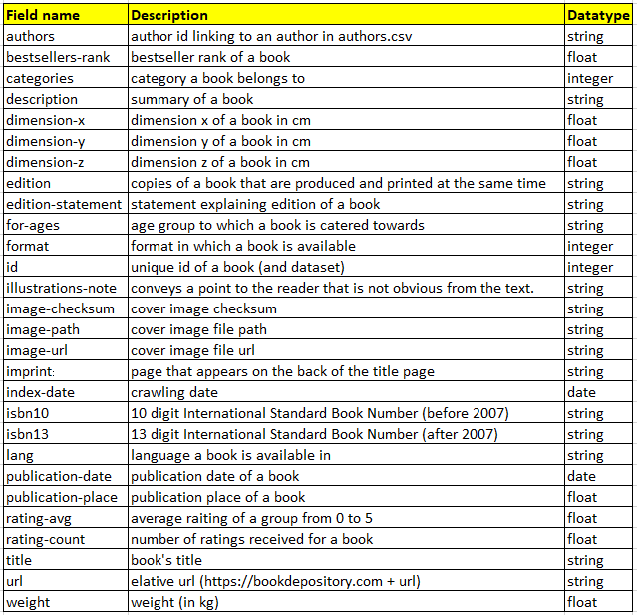
Business Metadata

Slide 10
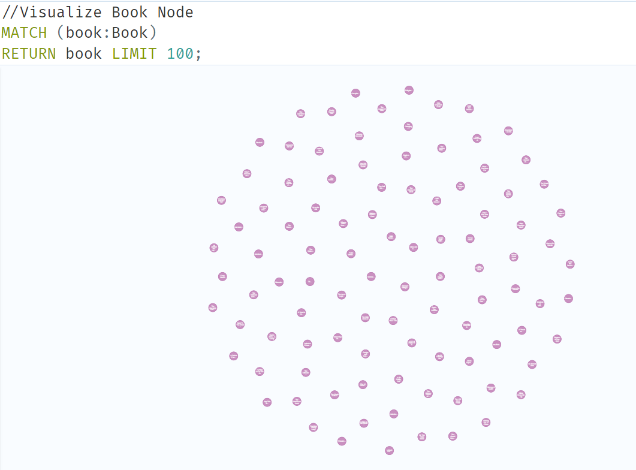
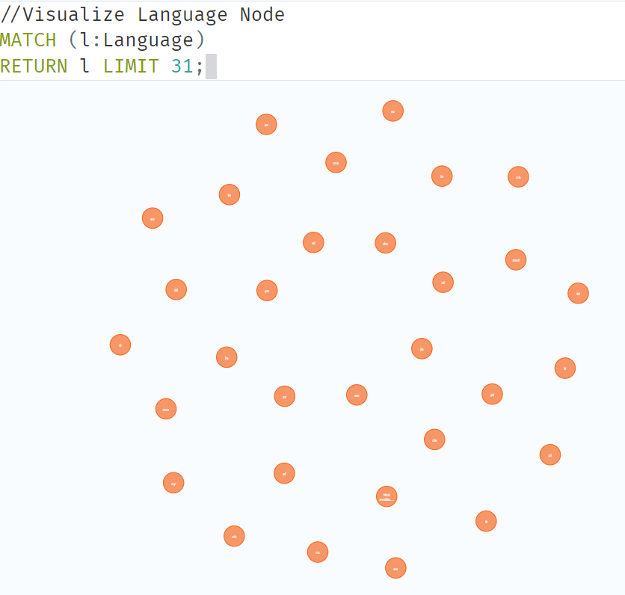
Data Validation and Data Visualization
Graph nodes were created on neo4j as follows:
Book Node: Language Node:

Slide 11
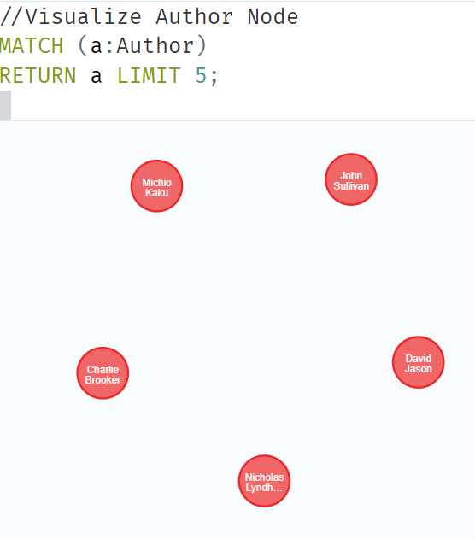
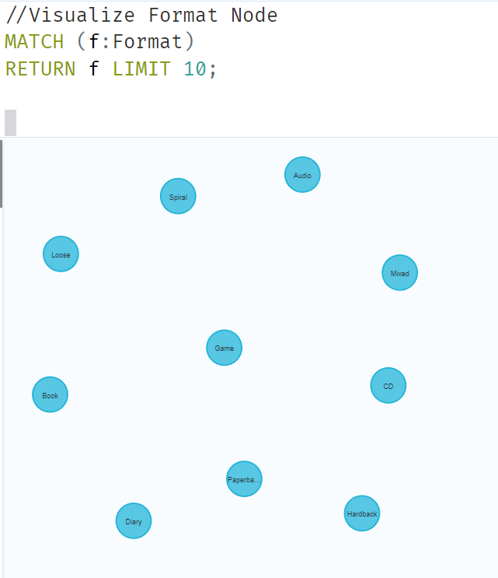
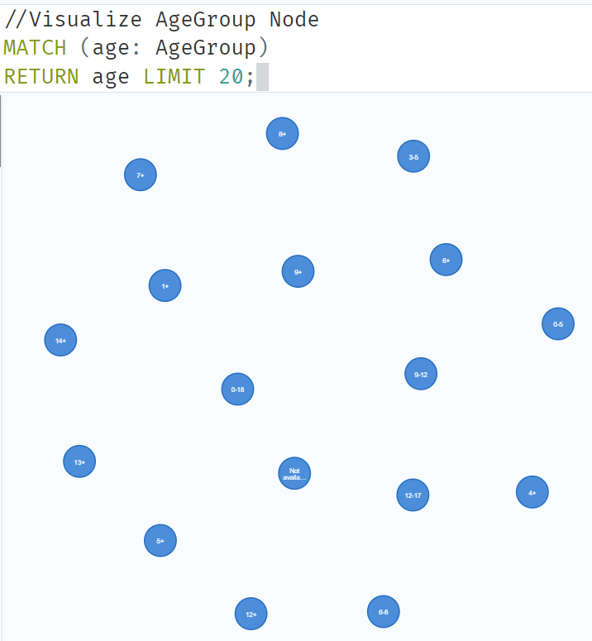
Data Validation and Data Visualization
Author Node: Format Node: AgeGroup Node:

Slide 12
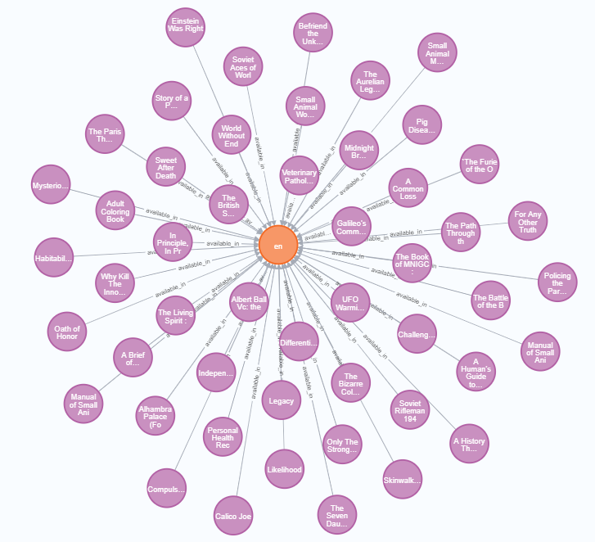
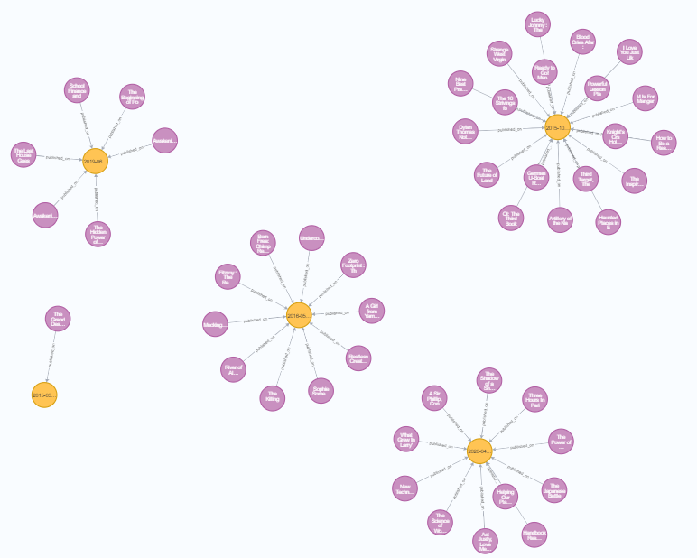
Data Validation and Data Visualization
Some relationships are as follows:
Book-Language: Book-Publication:

Slide 13
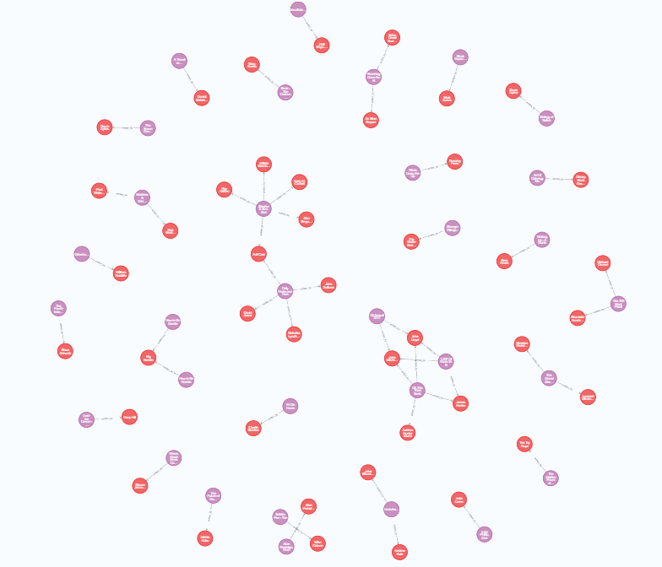
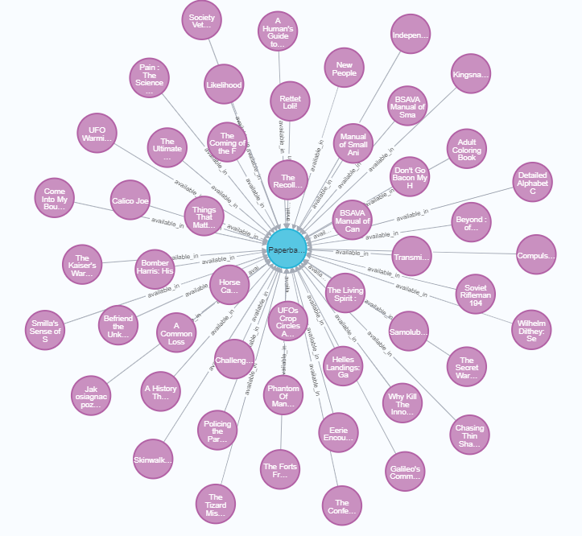
Data Validation and Data Visualization
Some relationships are as follows:
Book-Author: Book-Format:

Slide 14
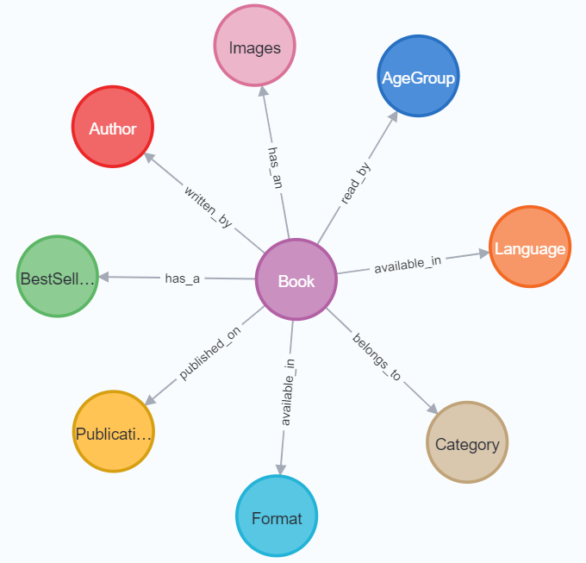
Data Validation and Data Visualization
Final graph model is as follows:

Slide 15

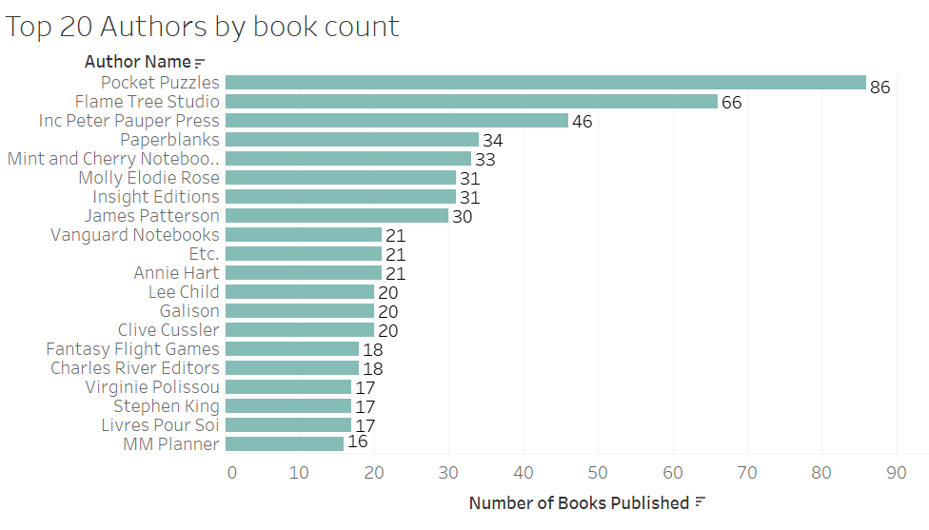
Visualization Interpretation
This is the total number of unique books that we have in the depository.
The above visualization shows Top 20 Authors who have the maximum number of books published in the book depository. One observation we made is that most author names are essentially publication names.

Slide 16
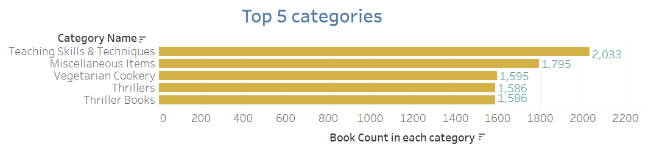
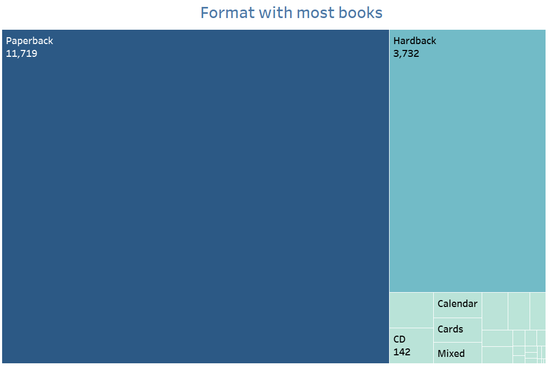
Visualization Interpretation
This visualization is about the Top 5 categories of books that were published in the depository. We observed that there is a bigger gap in number of books published between the Top 2 categories relative to any other categories.
This visualization is about the different formats being used for books. We clearly observe that paperback is the most preferred format in books followed by hardback.

Slide 17
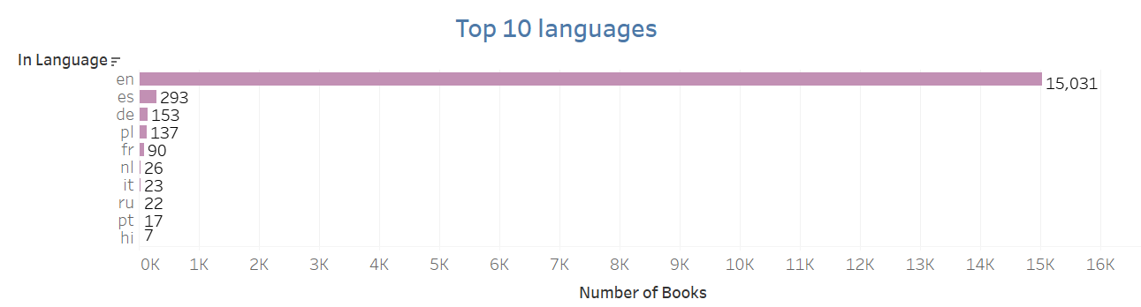
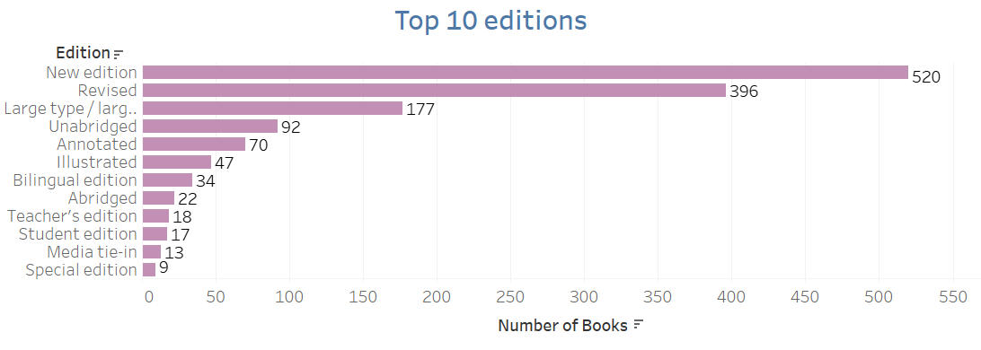
Visualization Interpretation
The above visualization is about Top 10 languages in which the books were published. We observed that English is clearly the most known language the books are published in.
The visualization shows Top 10 editions of books published.

Slide 18
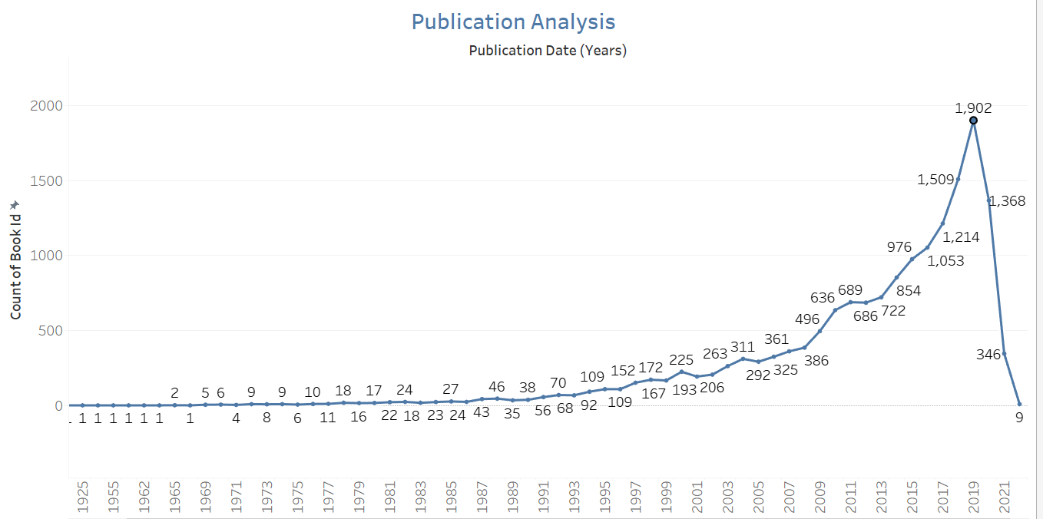
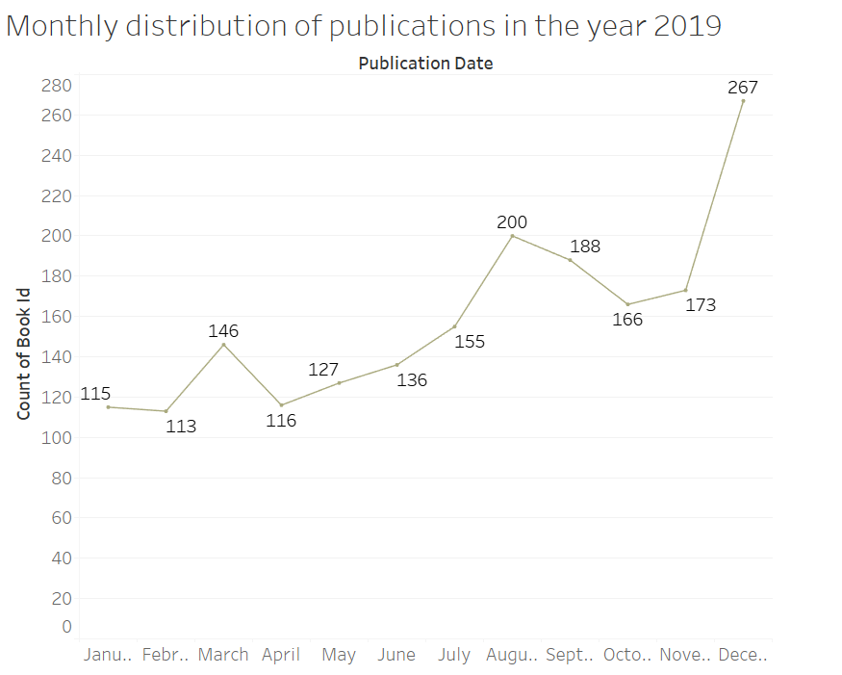
Visualization Interpretation
This visualization shows the books published over the years. We observe that 2019 had the highest number of publications i.e. 1902
Monthly publication distribution in the year 2019 as it was the year in which most books were published.

Slide 19
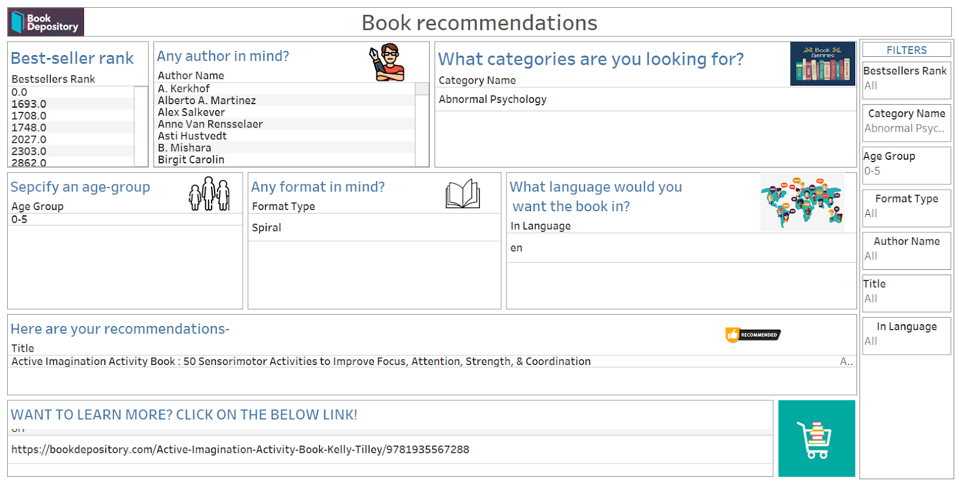
Visualization Interpretation
DASHBOARD 1
We have created a Book Recommendation Dashboard where the user can give their reading preferences and get book recommendations. It will then take you to the book’s online depository link from where you can learn more about the book, and even make a purchase.

Slide 20
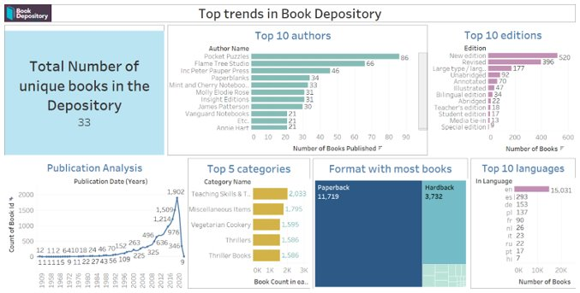
Visualization Interpretation
DASHBOARD 2:
This dashboard is a visualization of the top trends in our Book Depository Dataset.

Slide 21
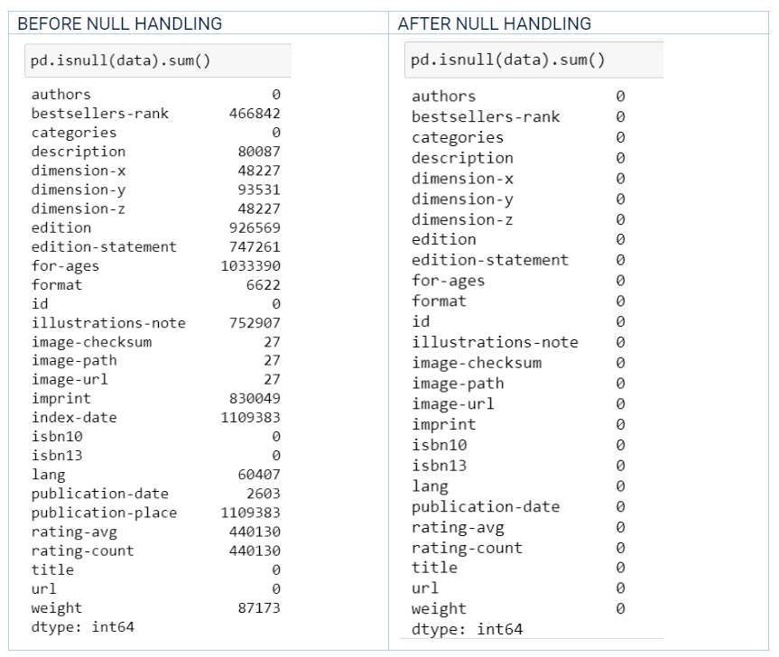
System Integration and User Acceptance Testing
Test 1: Attribute null value check
Number of null values was accessed before and after data wrangling. Null values were not removed but were altered for use in data analysis.

Slide 22
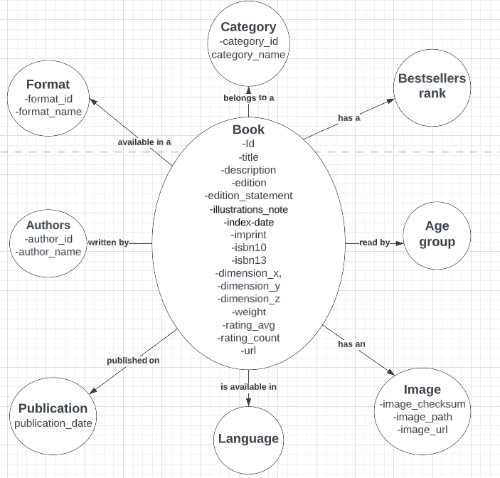
System Integration and User Acceptance Testing
Test 2: Model design check
We started off with a model design before uploading our csv file to neo4j and creating the nodes and relationships. This test is to ensure that we implement a graph model based on the design we had in mind while cleaning and integrating our data. This will also test if the properties of the node match with the attributes in our initial model design

Slide 23
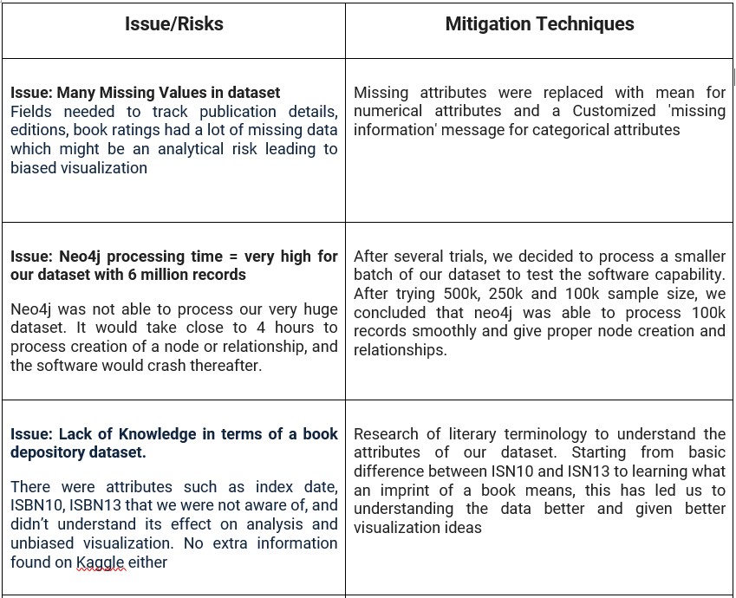
Risks and Issues

Slide 24
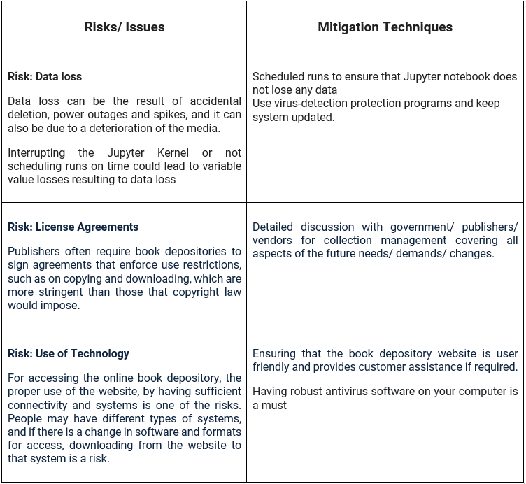
Risks and Issues

Slide 25
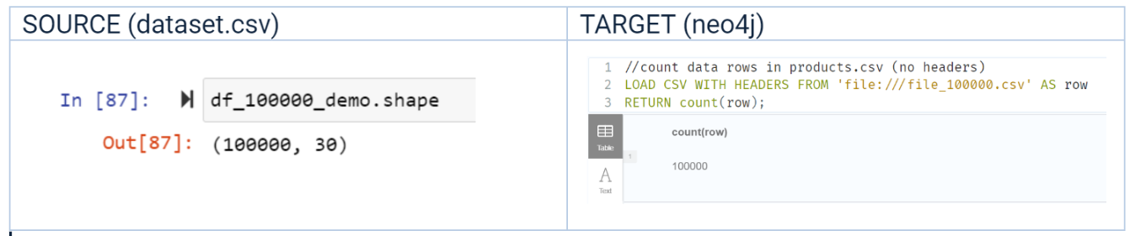
System Integration and User Acceptance Testing
Test 3: Record count match in source and target
After data cleaning, mapping and integration on Jupyter notebook, we loaded the final data on a csv file. This was then loaded to a neo4j database.
This test is to ensure that our Jupyter notebook created csv is properly loaded to the neo4j databases
Test 4: Unique record count match in source and target
Once we check the total record count, we test a unique count of each attribute with respect to the node created on neo4j.
This will test the mapping conducted on Jupyter notebook, and should ideally give an equal record count between source and target.

Slide 26
Challenges Encountered
1 lookup file- places.csv was completely empty
During data profiling, we found out that there were several columns in our main dataset(i.e.dataset.csv) which were entirely null making it redundant to data analysis
Our analysis on publications was narrowed down due to the absence of data in the lookup file- places.csv
Categories and authors were given in the form of a list for each book record. Transformation had to be performed on this to make it usable for deeper analysis.
After successfully cleaning and integrating our data, we had 6111640 records and 29 columns. Loading this on Neo4j was a tedious task. neo4j was not able to process this size. Our laptop RAM was not good enough to process this as well. The query would run for 3 hours ,create close to 100k relationships (out of 5 million) and then crash. We tried loading in different batch sizes of 1000000 rows ,followed by 200,000 rows and then 100000 rows which led to successful execution
Most of our attribute names had a ‘hyphen’ in them. Neo4j failed to recognize and read these names as is- .In order to solve this, we cleaned our attribute names and renamed them with an underscore in place of hyphen.
After successfully loading data on the Neo4j database, there were issues in downloading precise connectors for connecting neo4j to Tableau.

Slide 27
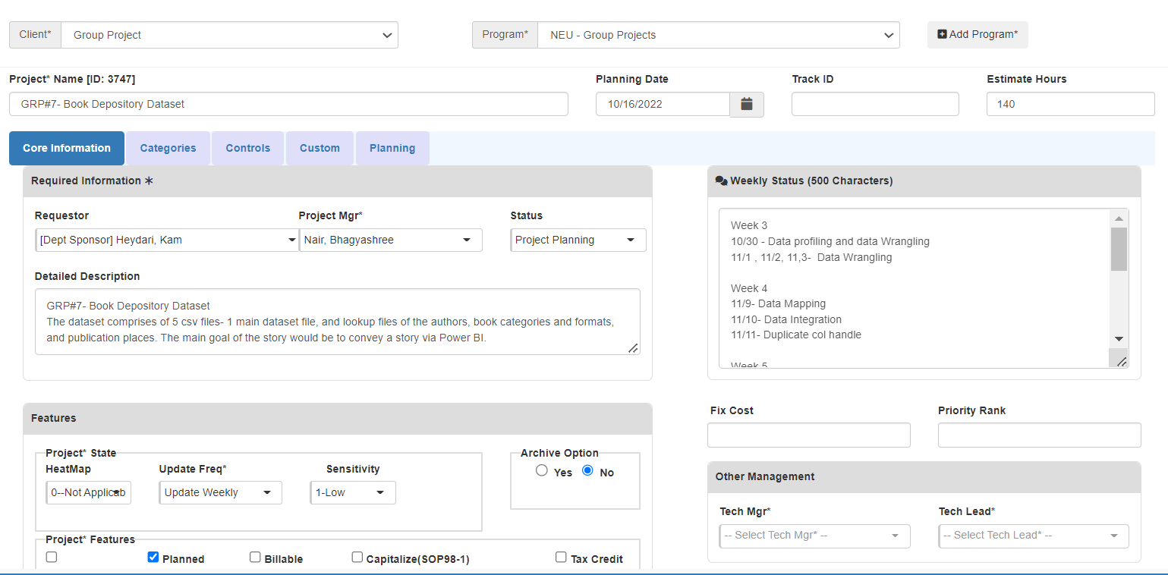
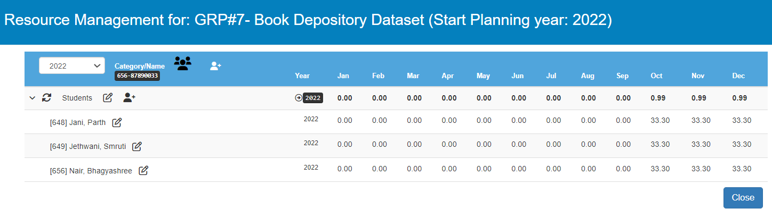
Velero Portal
Project
Resource Allocation

Slide 28
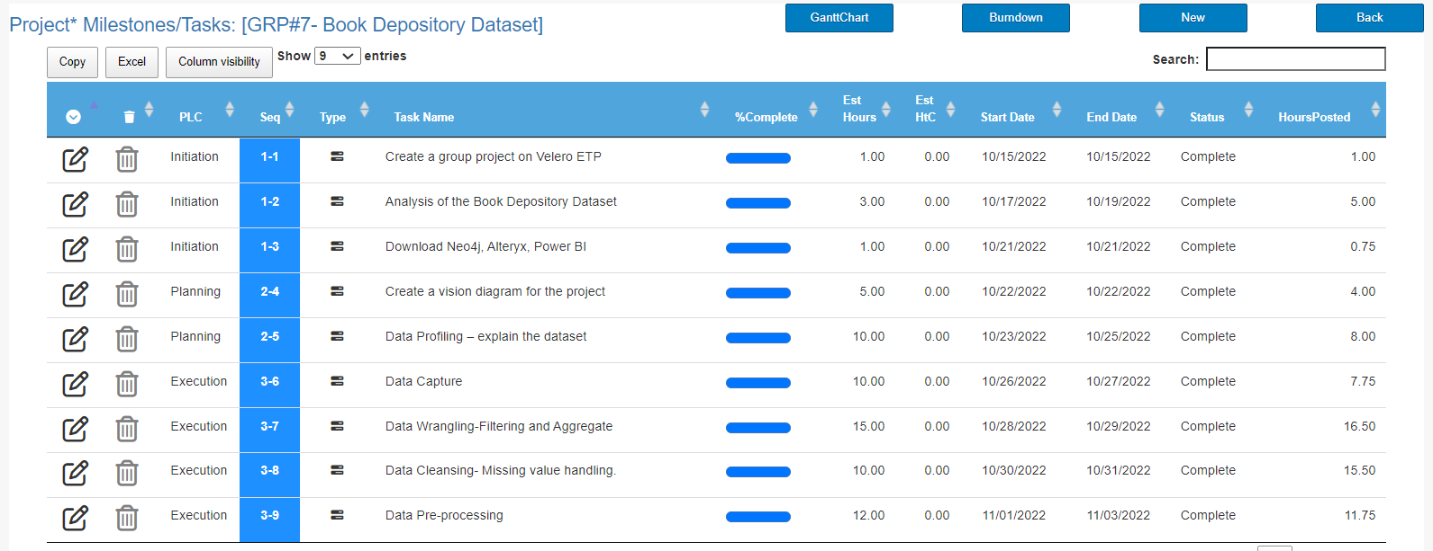
Velero Portal
Project Plan

Slide 29
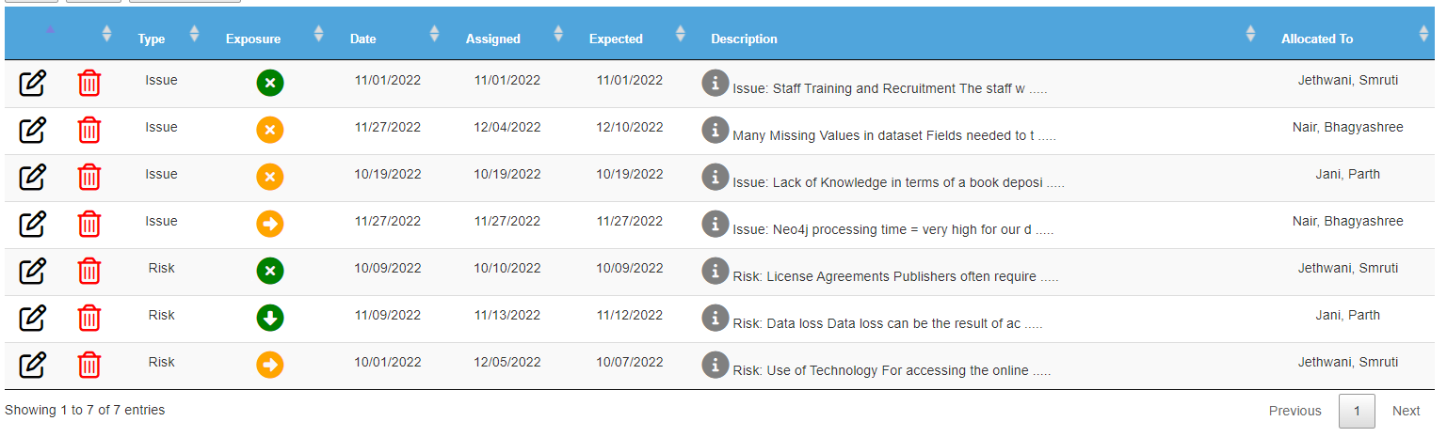
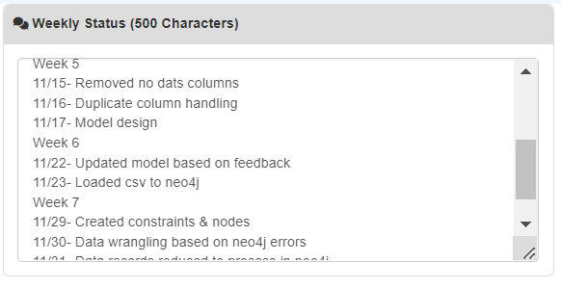
Velero Portal
Issues and Risks
Weekly updates

